Slide 1

AIDL_02 Neural Networks and Deep Learning
Project: CHESS OPENINGS CLASSIFICATIONS
By Student: Christos Kormaris
MSc Program in Artificial Intelligence & Deep Learning, University of West Attica
Instructor: Panagiotis Kasnesis

Slide 2
Contents
Know Your Data
CNN1 (Keras Grayscale)
CNN2 (PyTorch Grayscale)
CNN3 (PyTorch RGB)
Data Augmentation on CNN1
VGG16 Transfer Learning CNN
ResNet Transfer Learning CNN
Data Augmentation on VGG16 Transfer Learning CNN

Slide 3
KNOW YOUR DATA

Slide 4
Dataset
Custom dataset collected by myself
285 total images (400x400 pixels)
5 classes (Ruy Lopez, Italian Game, Queen’s Gambit, Sicilian Defense, Nimzo-Indian Defense)
57 images per class (55 graphical chess boards + 2 real chess boards)
1 real chess board in validation set
1 real chess board in test set
192 images for train set
46 images for validation set
47 images for test set

Slide 5
Preprocessing
Convert 400x400 images to 100x100 for memory efficiency and faster execution
Option to use grayscale or RGB images
Option to augment the train dataset using 2 techniques:
Brightening/Darkening (5 additional images for each example, 3 darker plus 2 brighter, for both grayscale and RGB images)
Channel Shifting (3 additional images for each example, use only red, green or blue channel each time, only for RGB images)
Use Min-Max Normalization to convert pixel values from range [0-255] into range [0-1]

Slide 6
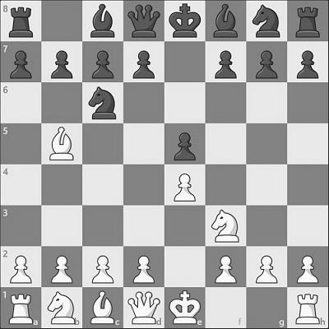
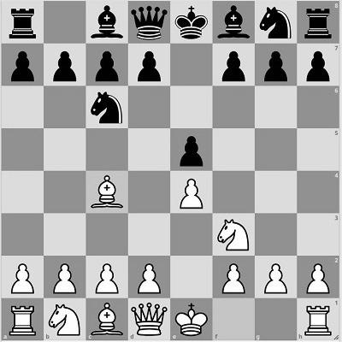
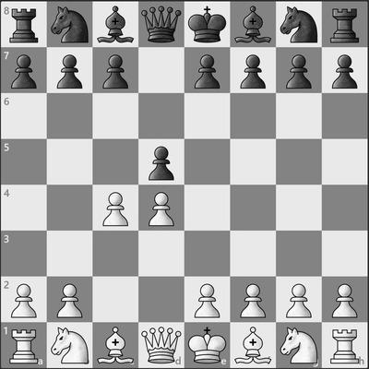
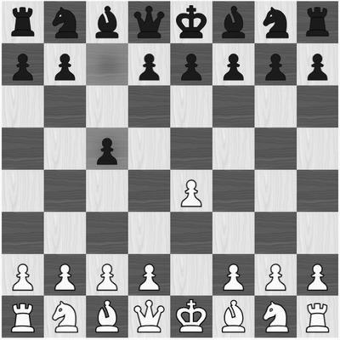
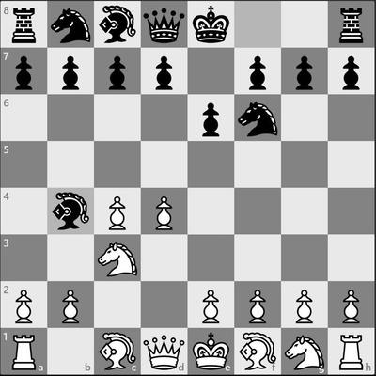
Dataset Examples Grayscale Images
Ruy Lopez
Italian Game
Queen’s Gambit
Sicilian Defense
Nimzo-Indian Defense

Slide 7
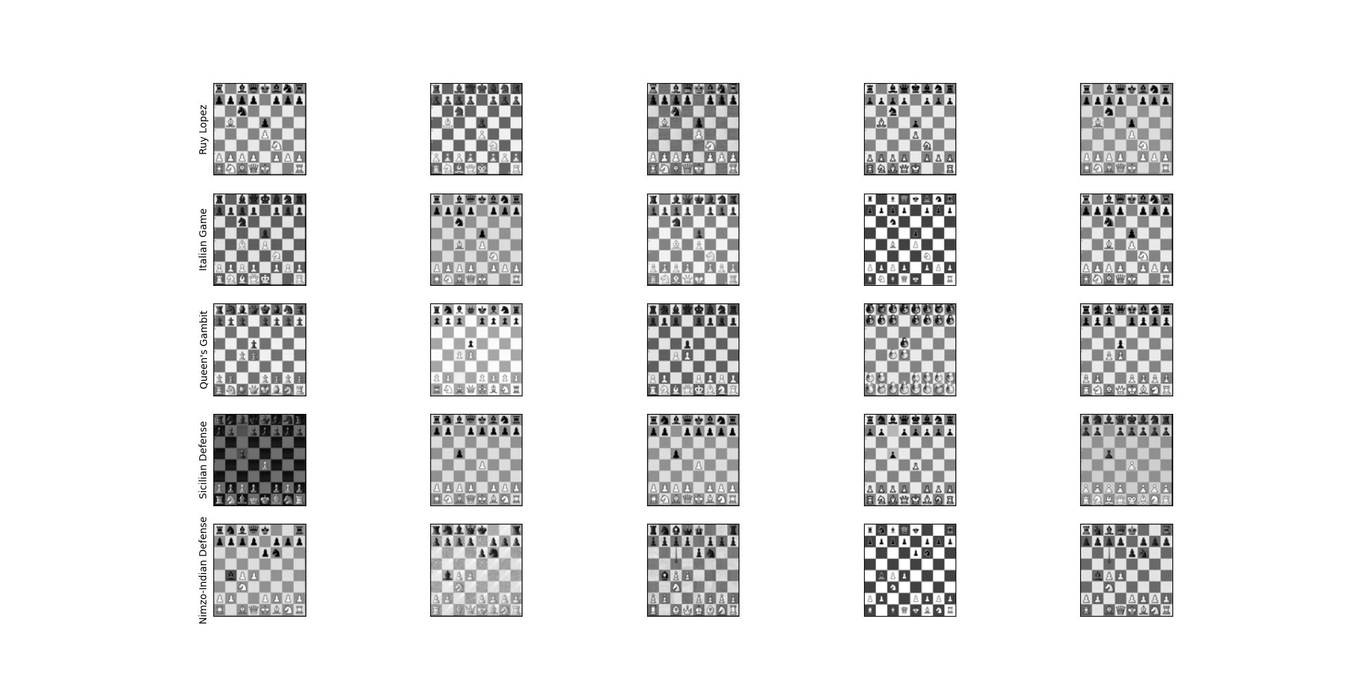

Slide 8
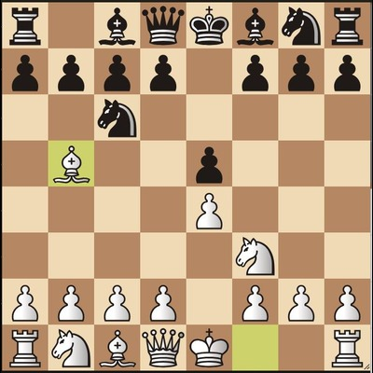
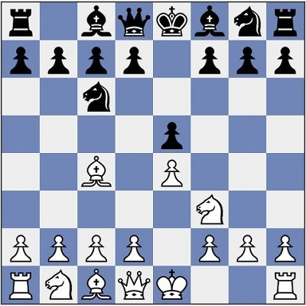
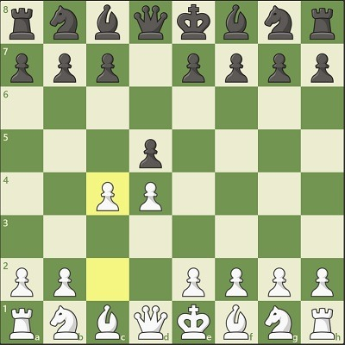
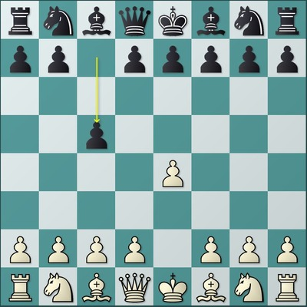
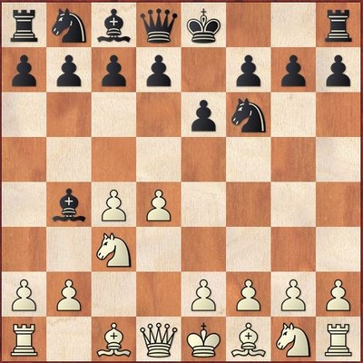
Dataset Examples RGB Images
Ruy Lopez
Italian Game
Queen’s Gambit
Sicilian Defense
Nimzo-Indian Defense

Slide 9
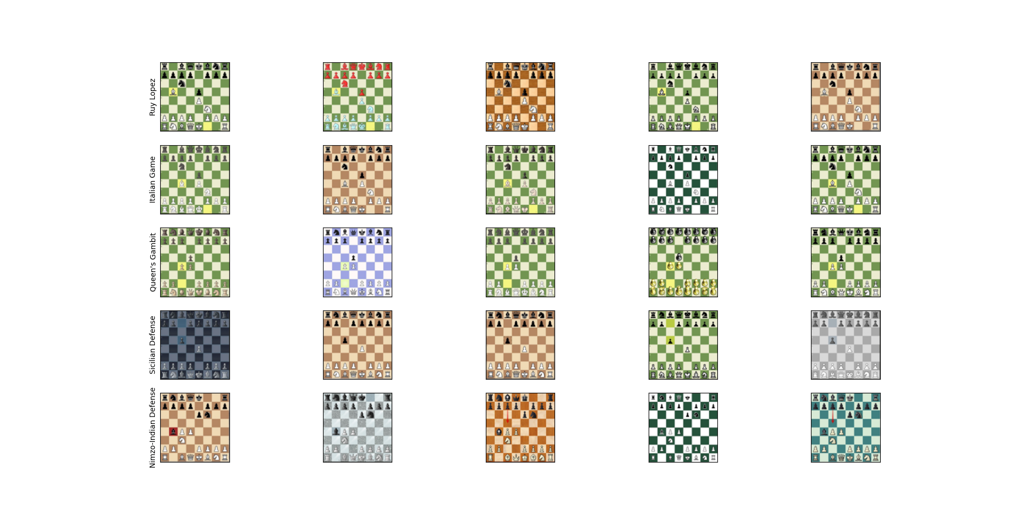

Slide 10
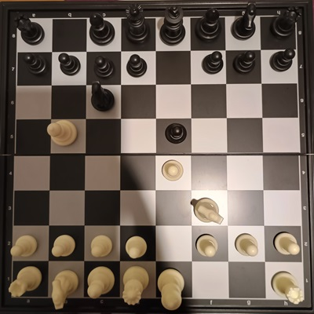
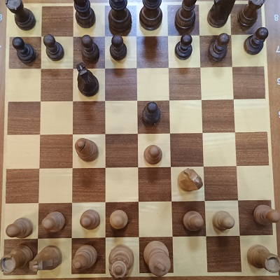
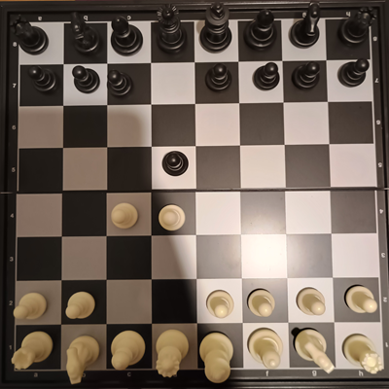
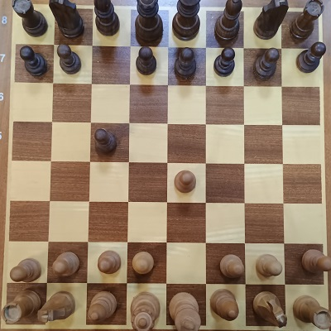
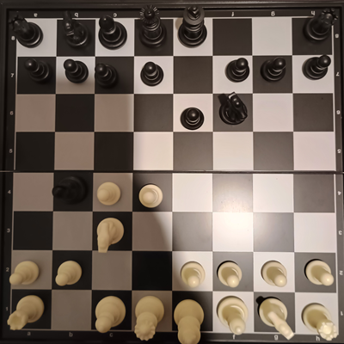
RGB Real Images
Ruy Lopez
Italian Game
Queen’s Gambit
Sicilian Defense
Nimzo-Indian Defense

Slide 11
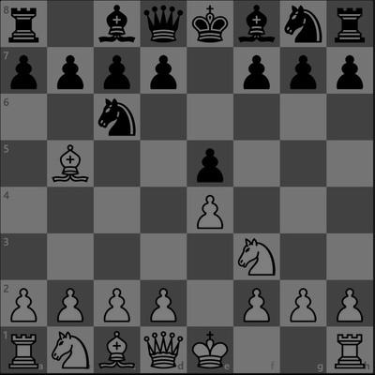
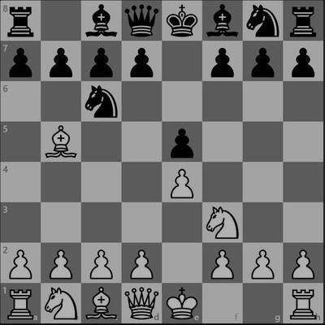
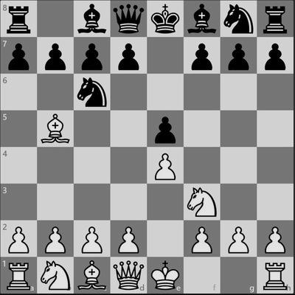
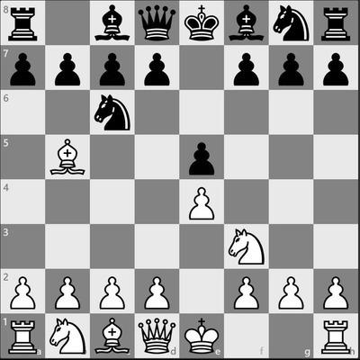
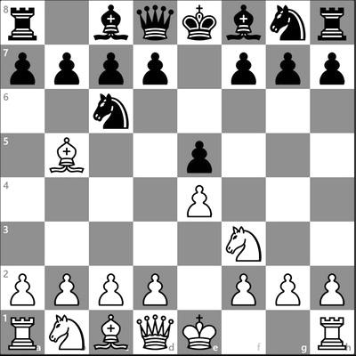
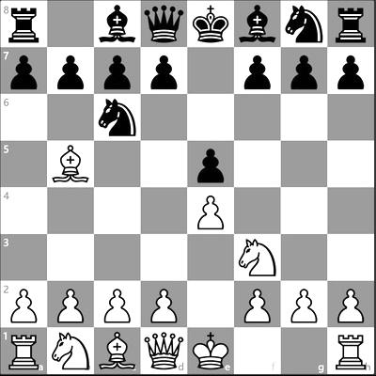
Augmented Images - Grayscale Brighter/Darker
50% Darker
30% Darker
10% Darker
Original Image
10% Brighter
20% Brighter

Slide 12
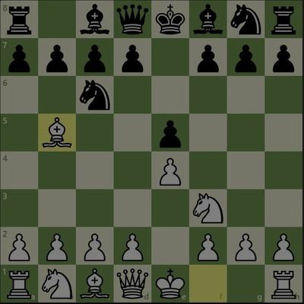
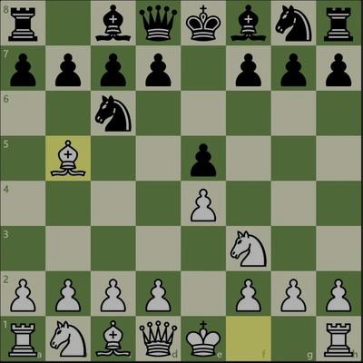
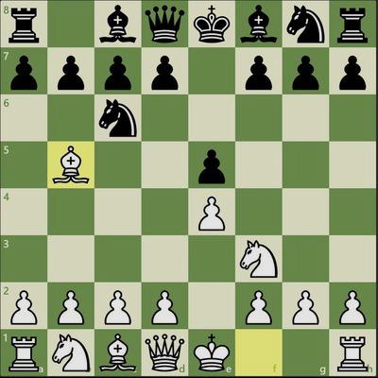
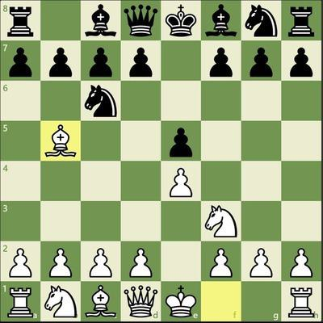
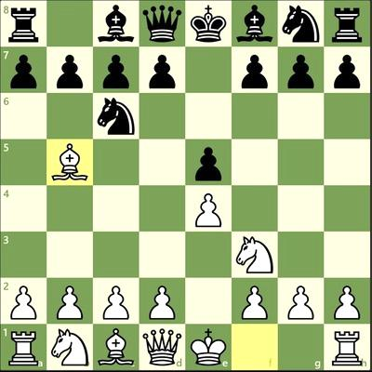
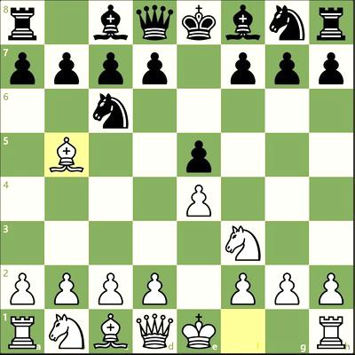
Augmented Images - RGB Brighter/Darker
50% Darker
30% Darker
10% Darker
Original Image
10% Brighter
20% Brighter

Slide 13
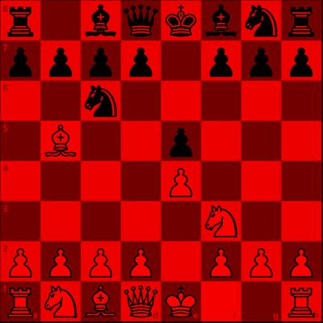
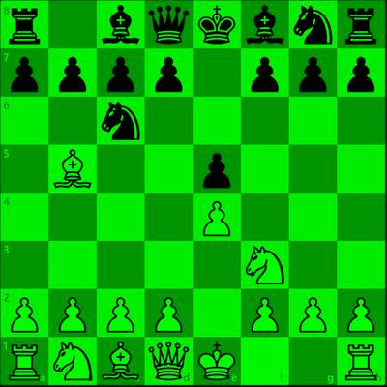
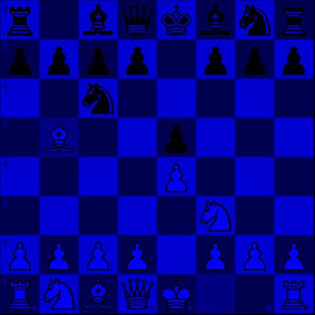
Augmented Images - RGB Channel Shifting
Original Image
Red Channel Only
Green Channel Only
Blue Channel Only

Slide 14
CNN1 - Keras Grayscale

Slide 15
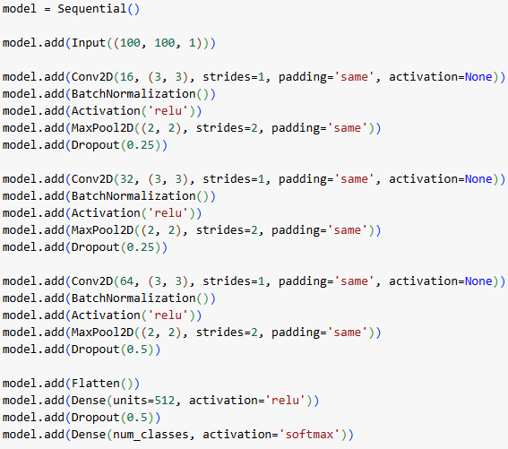
CNN1 - Architecture

Slide 16
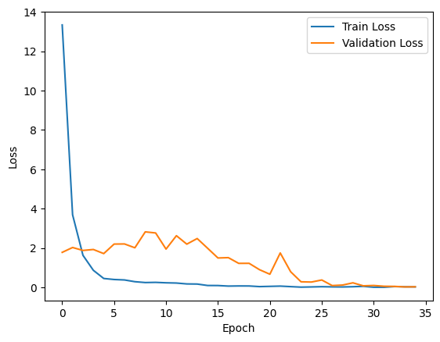
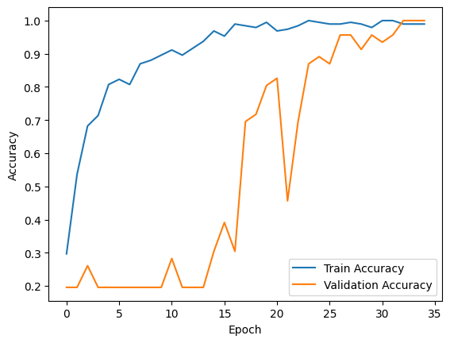
CNN1 - Run

Slide 17
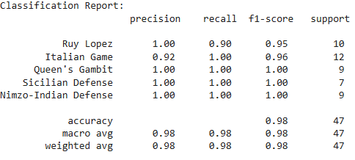
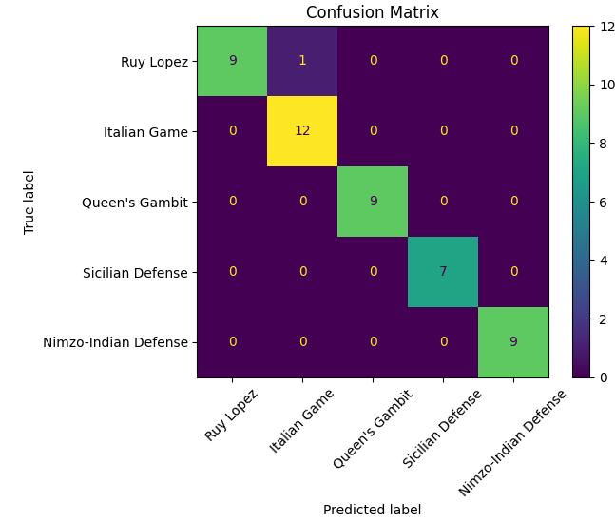

CNN1 - Test Data Metrics

Slide 18
CNN2 - Keras RGB

Slide 19
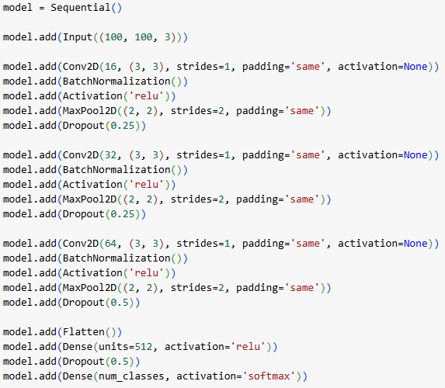
CNN2 - Architecture

Slide 20
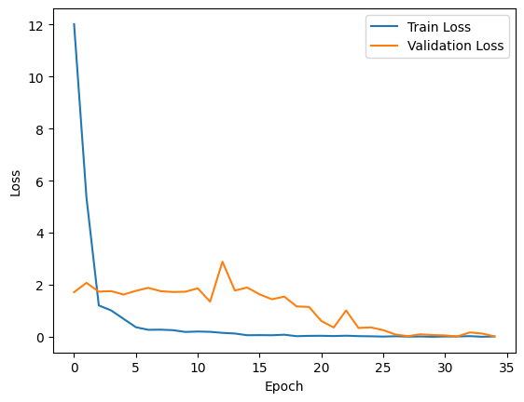
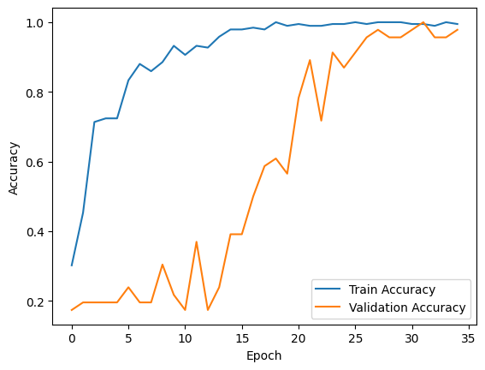
CNN2 - Run

Slide 21
CNN2 - Test Data Metrics
The metrics are exactly the same as the grayscale model.

Slide 22
CNN3 - PyTorch Grayscale

Slide 23
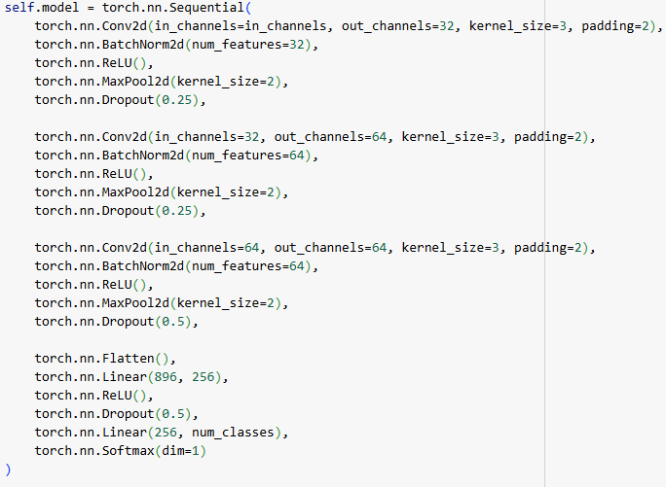
CNN3 - Architecture

Slide 24
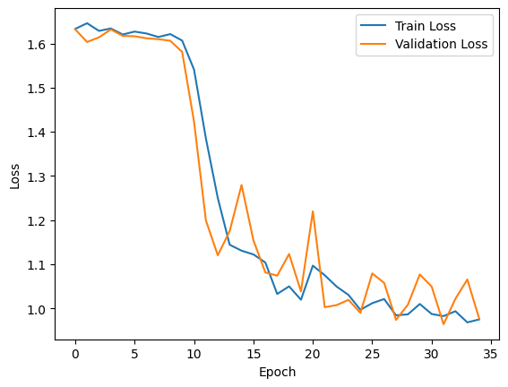
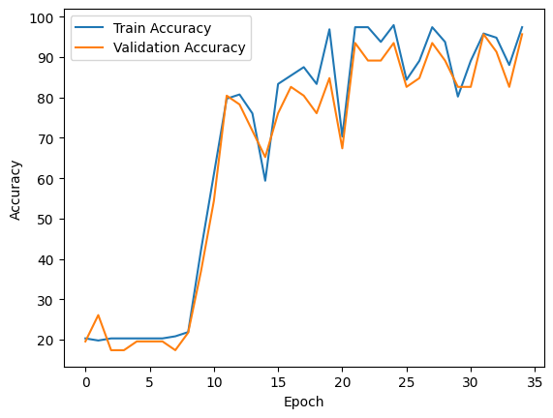
CNN3 - Run

Slide 25
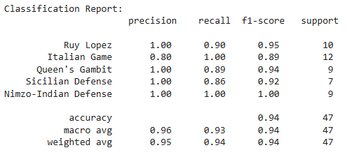
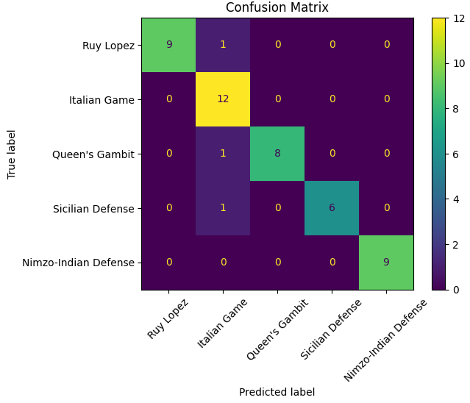

CNN3 - Test Data Metrics

Slide 26
CNN4 - PyTorch RGB

Slide 27
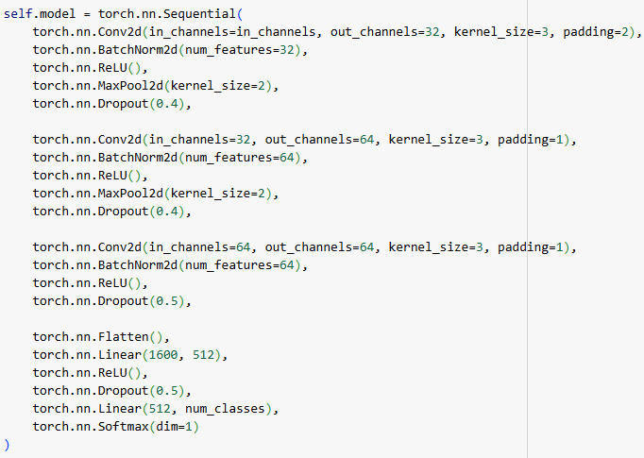
CNN4 - Architecture

Slide 28
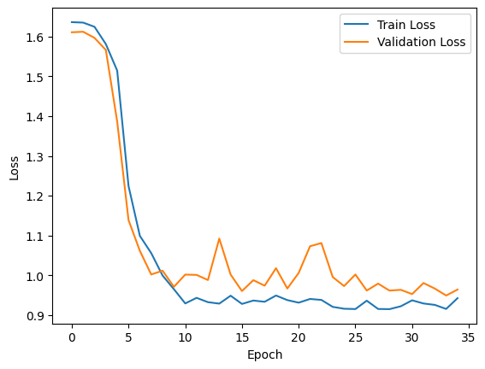
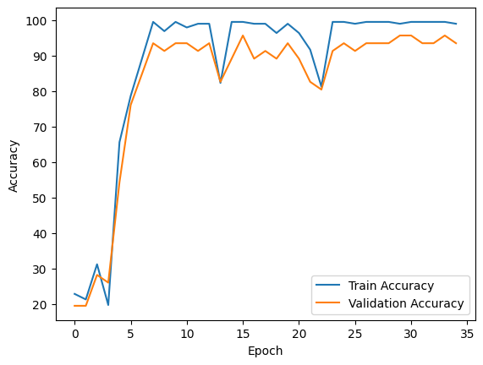
CNN4 - Run

Slide 29

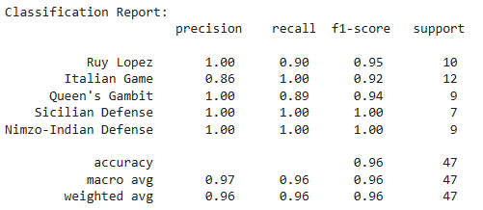

CNN4 - Test Data Metrics
Compared to the grayscale model there is 1 less false prediction.

Slide 30
Data Augmentation on CNN1

Slide 31
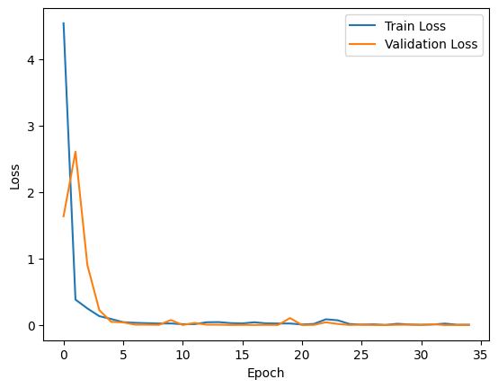

Data Augmentation on CNN1 - Run
Compared to the non-augmented run there are less oscillations in the augmented model.
Validation loss and accuracy are steadily converging.

Slide 32



Data Augmentation on CNN1 Test Data Metrics
Compared to the non-augmented model there is 1 less false prediction.
Also, accuracy and all metrics are 100 %!

Slide 33
VGG16 Transfer Learning CNN

Slide 34

VGG16 CNN - Architecture

Slide 35


VGG16 CNN - Run

Slide 36



VGG16 CNN - Test Data Metrics

Slide 37
ResNet Transfer Learning CNN

Slide 38

ResNet CNN - Architecture

Slide 39


ResNet CNN - Run

Slide 40



ResNet CNN - Test Data Metrics
We can see that the model has overfitted the Ruy Lopez class.

Slide 41
Data Augmentation on VGG16 Transfer Learning CNN

Slide 42


Data Augmentation on VGG16 CNN - Run

Slide 43



Data Augmentation on VGG16 CNN Test Data Metrics
Compared to the non-augmented model there are 2 less false predictions.
Also the metrics of the classes Ruy Lopez & Italian Game are much better.

Slide 44
DEMO & DEPLOYMENT
https://web-production-850b3.up.railway.app

Slide 45
QUESTIONS

Slide 46
THANK YOU

